Slide 1
Deriving Private Information from Randomized Data
Zhengli Huang
Wenliang (Kevin) Du
Biao Chen
Syracuse University

Slide 2
Privacy-Preserving Data Mining
Classification
Association Rules
Clustering
Data Mining
Central Database
Data Collection
Data Disguising

Slide 3
Random Perturbation
Original Data X
Random Noise R
Disguised Data Y
+

Slide 4
How Secure is
Randomization Perturbation?

Slide 5
A Simple Observation
We can’t perturb the same number for several times.
If we do that, we can estimate the original data:
  Let t be the original data,
  Disguised data: t + R₁, t + R₂, …, t + R_{m}
  Let Z = [(t+R₁)+ … + (t+R_{m})] / m
  Mean: E(Z) = t

Slide 6
This looks familiar …
This is the data set (x, x, x, x, x, x, x, x)
Random Perturbation:
  (x+r₁, x+r₂,……, x+r_{m})
We know this is NOT safe.
Observation: the data set is highly correlated.

Slide 7
Let’s Generalize!
Data set: (x₁, x₂, x₃, ……, x_{m})
If the correlation among data attributes are high, can we use that to improve our estimation (from the disguised data)?

Slide 8
Data Reconstruction (DR)
Distribution
of random noise
Reconstructed Data X’
Data Reconstruction
What’s their
difference?
Disguised Data Y
Original Data X

Slide 9
Reconstruction Algorithms
Principal Component Analysis (PCA)
Bayes Estimate Method

Slide 10
PCA-Based
Data Reconstruction

Slide 11
PCA-Based Reconstruction
Disguised
Information
Reconstructed
Information
Squeeze
Information Loss

Slide 12
How?
Observation:
  Original data are correlated.
  Noise are not correlated.
Principal Component Analysis
  Useful for lossy compression

Slide 13
PCA Introduction
The main use of PCA: reduce the dimensionality while retaining as much information as possible.
1st PC: containing the greatest amount of variation.
2nd PC: containing the next largest amount of variation.

Slide 14
For the Original Data
They are correlated.
If we remove 50% of the dimensions, the actual information loss might be less than 10%.

Slide 15
For the Random Noises
They are not correlated.
Their variance is evenly distributed to any direction.
If we remove 50% of the dimensions, the actual noise loss should be 50%.

Slide 16
PCA-Based Reconstruction
Disguised Data
PCA Compression
De-Compression
Reconstructed
Data
Original Data X

Slide 17
Bayes-Estimation-Based
Data Reconstruction

Slide 18

A Different Perspective
Possible X
Possible X
Possible X
What is the
Most likely X?
Random Noise
Disguised Data Y

Slide 19
The Problem Formulation
For each possible X, there is a probability: P(X | Y).
Find an X, s.t., P(X | Y) is maximized.
How to compute P(X | Y)?

Slide 20

The Power of the Bayes Rule
P(X|Y)?
P(X|Y)
is difficult!
P(Y|X)
P(X)
*
P(Y)

Slide 21
Computing P(X | Y)?
P(X|Y) = P(Y|X)* P(X) / P(Y)
P(Y|X): remember Y = X + R
P(Y): A constant (we don’t care)
How to get P(X)?
  This is where the correlation can be used.
  Assume Multivariate Gaussian Distribution
    The parameters are unknown.

Slide 22
Multivariate Gaussian Distribution
A Multivariate Gaussian distribution
  Each variable is a Gaussian distribution with mean μ_{i}
  Mean vector μ = (μ₁ ,…, μ_{m})
  Covariance matrix Σ
Both μ and Σ can be estimated from Y
So we can get P(X)

Slide 23
Bayes-Estimate-based Data Reconstruction
Randomization
Original X
Disguised
Data Y
Estimated X
Which X maximizes
P(X|Y)
P(Y|X)
P(X)

Slide 24
Evaluation

Slide 25
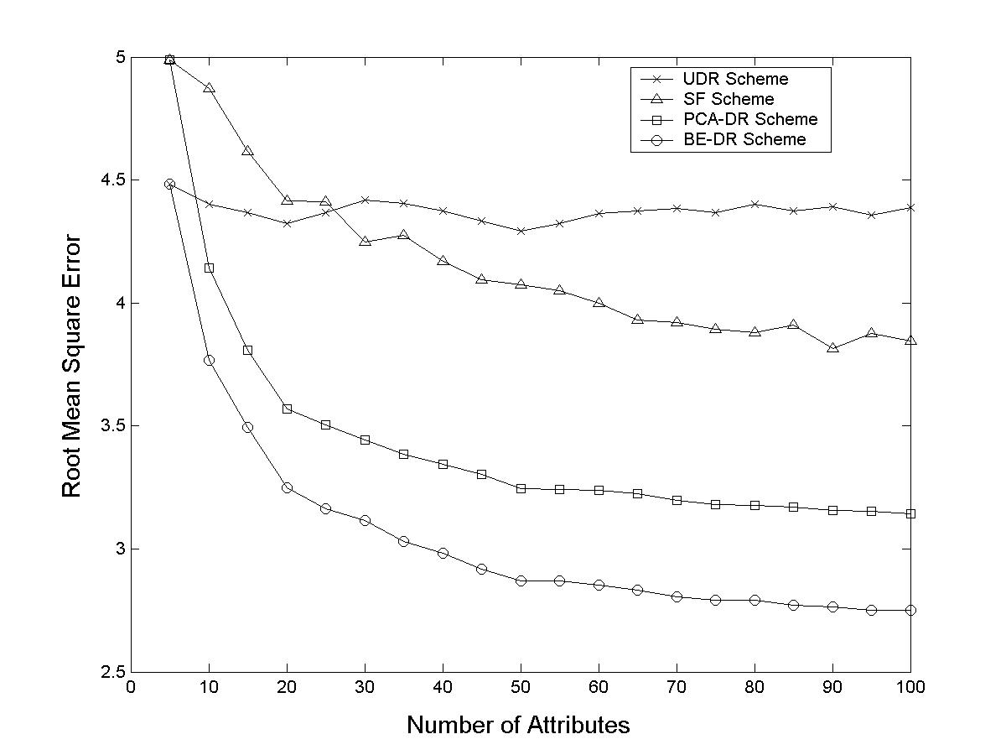
Increasing the Number of Attributes

Slide 26
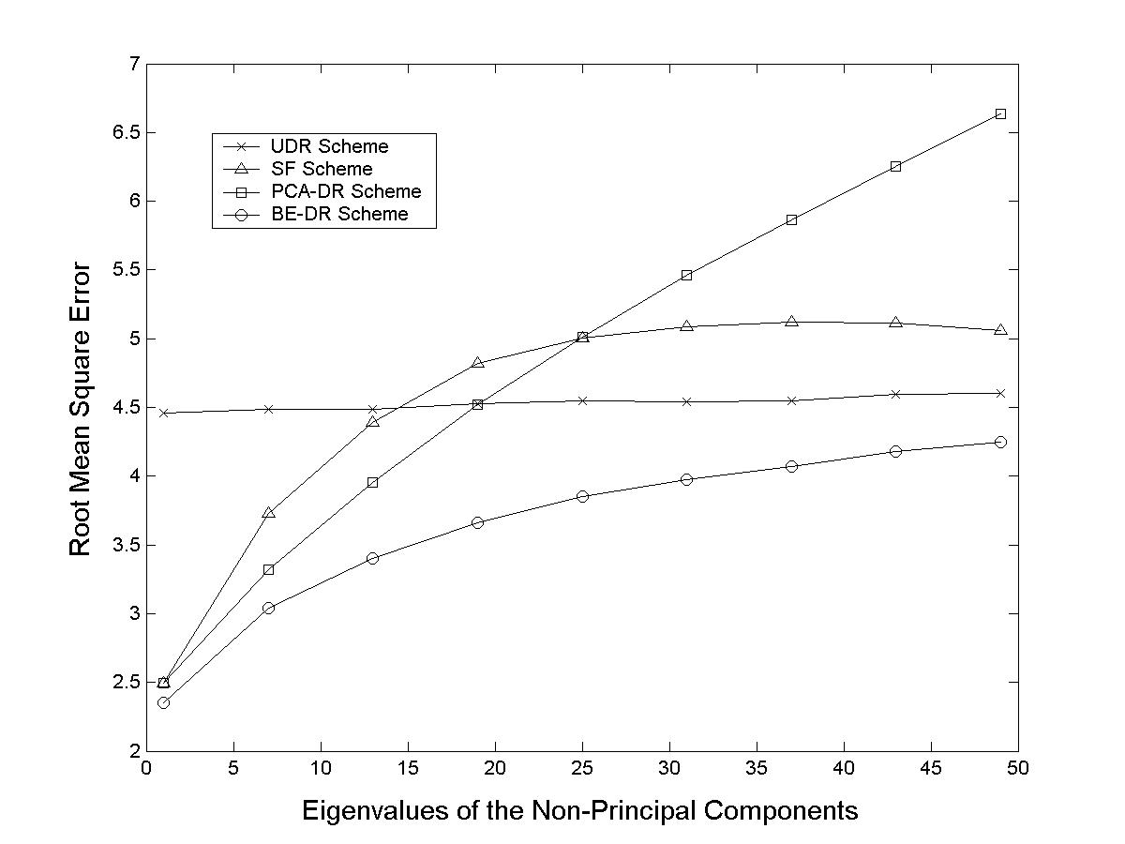
Increasing Eigenvalues of the Non-Principal Components

Slide 27
How to improve
Random Perturbation?

Slide 28
Observation from PCA
How to make it difficult to squeeze out noise?
  Make the correlation of the noise similar to the original data.
  Noise now concentrates on the principal components, like the original data X.
How to get the correlation of X?

Slide 29
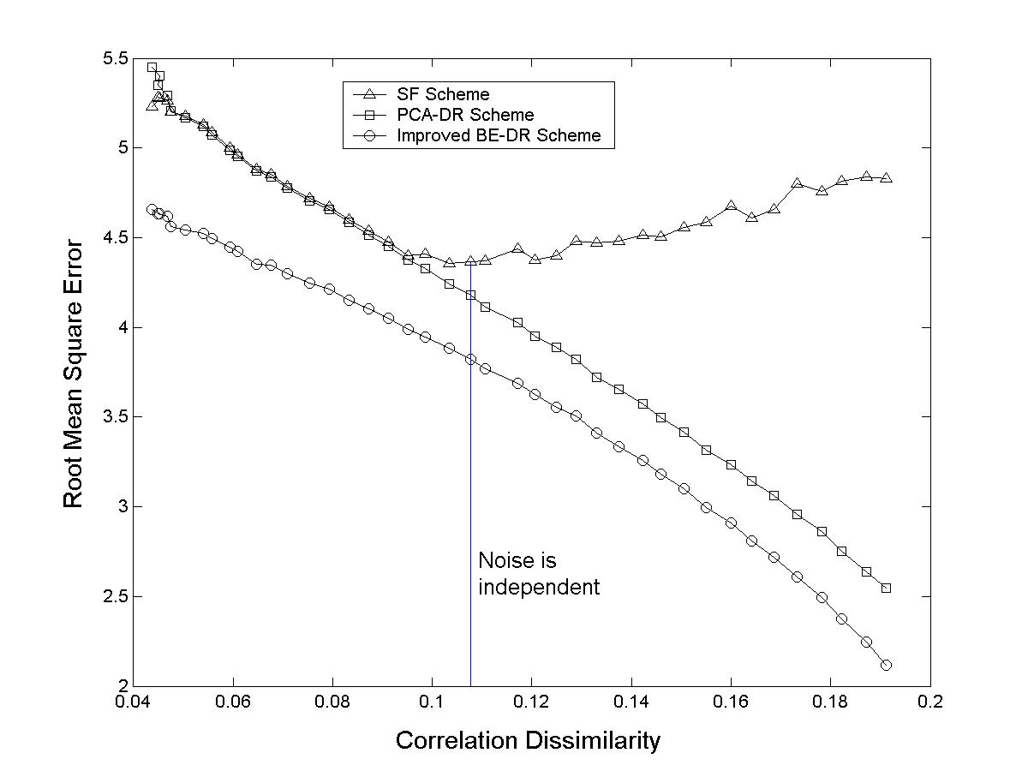
Improved Randomization

Slide 30
Conclusion And Future Work
When does randomization fail:
  Answer: when the data correlation is high.
  Can it be cured? Using correlated noise similar to the original data
Still Unknown:
  Is the correlated-noise approach really better?
  Can other information affect privacy?

